Slide 1



Academic Session 2020-21 (Even Semester)
Department of Computer Engineering

Slide 2

Self-Introduction
Name: Deepak Moud
Qualification: BE, MTECH, PhD(Persuing)
Designation: Head of Department
Research Area: Image Processing, Machine Learning, Deep learning, data Mining
E-mail Id: deepakmoud@poornima.org
Phone Number: 07568748510

Slide 3
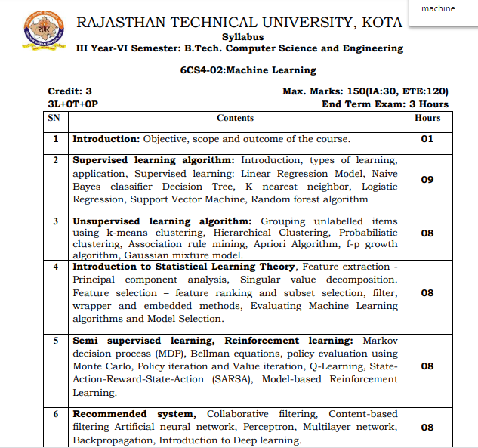
Syllabus

Slide 4
Books
Sr. No. | Title of the book | Author
1 | Machine Learning | Anuradha Srinivasaraghavan, Vincy Joseph
2 | Data Mining Concepts and Techniques | Jiawei Han University of Illinois at Urbana–Champaign Micheline Kamber Jian Pei Simon Fraser University

Slide 5
This document contains images obtained by routine Google Images searches. Some of these images may perhaps be under copyright. They are included here for educational and noncommercial purposes and are considered to be covered by the doctrine of Fair Use. In any event they are easily available from Google Images.
Public Notice regarding Use of Images
It's not feasible to give full scholarly credit to the creators of these images. We hope they can be satisfied with the positive role they are playing in the educational process.
2

Slide 6
Ensemble Methods: Increasing the Accuracy
Ensemble methods
■ Use a combination of models to increase accuracy
■ Combine a series of k learned models, M1, M2, …, Mk, with the aim of creating an improved model M*

Slide 7
Random Forest Algorithm
Random Forest is a popular machine learning algorithm that belongs to the supervised learning technique. It can be used for both Classification and Regression problems in ML. It is based on the concept of ensemble learning, which is a process of combining multiple classifiers to solve a complex problem and to improve the performance of the model.
As the name suggests, "Random Forest is a classifier that contains a number of decision trees on various subsets of the given dataset and takes the average to improve the predictive accuracy of that dataset." Instead of relying on one decision tree, the random forest takes the prediction from each tree and based on the majority votes of predictions, and it predicts the final output.
The greater number of trees in the forest leads to higher accuracy and prevents the problem of overfitting.

Slide 8
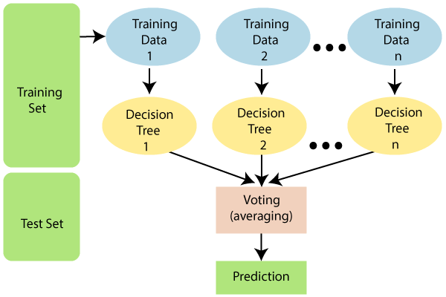

Slide 9

Similar to decision tree with a few differences
For each split-point, the search is not over all variables but just over a part of variables
No pruning necessary. Trees can be grown until each node contain just very few observations
Advantages over decision tree
Better prediction (in general)
No parameter tuning necessary with RF
Terminology
Training size (N)
Total number of attributes (M)
Number of attributes used (m)
Total number of trees (n)

Slide 10
Assumptions for Random Forest
Since the random forest combines multiple trees to predict the class of the dataset, it is possible that some decision trees may predict the correct output, while others may not. But together, all the trees predict the correct output. Therefore, below are two assumptions for a better Random forest classifier:
There should be some actual values in the feature variable of the dataset so that the classifier can predict accurate results rather than a guessed result.
The predictions from each tree must have very low correlations.
Why use Random Forest?
Below are some points that explain why we should use the Random Forest algorithm:
It takes less training time as compared to other algorithms.
It predicts output with high accuracy, even for the large dataset it runs efficiently.
It can also maintain accuracy when a large proportion of data is missing.

Slide 11


A random seed is chosen which pulls out at random a collection of samples from training dataset while maintaining the class distribution
With this selected dataset, a random set of attributes from original dataset is chosen based on user defined values. All the input variables are not considered because of enormous computation and high chances of over fitting
In a dataset, where M is the total number of input attributes in the dataset, only m attributes are chosen at random for each tree where m<M
The attribute for this set creates the best possible split using the gini index to develop a decision tree model. This process repeats for each of the branches until the termination condition stating that the leaves are the nodes that are too small to split.

Slide 12
The Working process can be explained in the below steps and diagram:
Step-1: Select random K data points from the training set.
Step-2: Build the decision trees associated with the selected data points (Subsets).
Step-3: Choose the number N for decision trees that you want to build.
Step-4: Repeat Step 1 & 2.
Step-5: For new data points, find the predictions of each decision tree, and assign the new data points to the category that wins the majority votes.

Slide 13
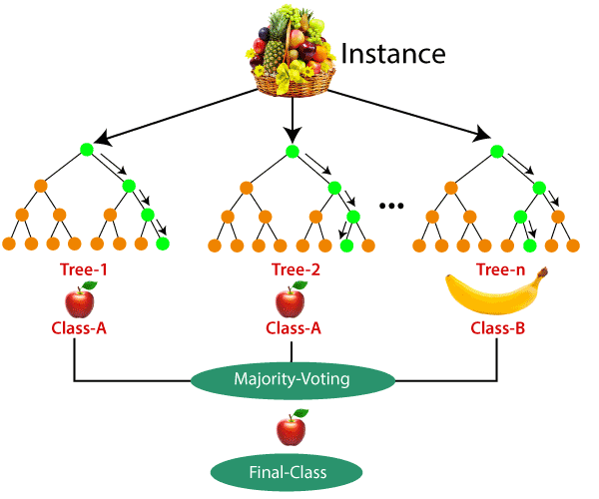
EXAMPLE
Suppose there is a dataset that contains multiple fruit images. So, this dataset is given to the Random forest classifier. The dataset is divided into subsets and given to each decision tree. During the training phase, each decision tree produces a prediction result, and when a new data point occurs, then based on the majority of results, the Random Forest classifier predicts the final decision. Consider the below image:

Slide 14



Information from random forest
Classification accuracy
Variable importance
Outliers (Classification)
Missing Data Estimation
Error Rates for Random Forest Object
Advantages
No need for pruning trees
Accuracy and variable importance generated automatically
Overfitting is not a problem
Not very sensitive to outliers in training data
Easy to set parameters

Slide 15

Limitations
Regression cant predict beyond range in the training data
Extreme values are not predicted accurately
Applications
Classification
Land cover classification
Cloud screening
Regression
Continuous field mapping
Biomass mapping

Slide 16
Example of Random forest Classification
User ID | Gender | Age | EstimatedSalary | Purchased
15624510 | Male | 19 | 19000 | 0
15810944 | Male | 35 | 20000 | 0
15668575 | Female | 26 | 43000 | 0
15603246 | Female | 27 | 57000 | 0
15804002 | Male | 19 | 76000 | 0
15728773 | Male | 27 | 58000 | 0
15598044 | Female | 27 | 84000 | 0
15694829 | Female | 32 | 150000 | 1
15600575 | Male | 25 | 33000 | 0
15727311 | Female | 35 | 65000 | 0
15570769 | Female | 26 | 80000 | 0
15606274 | Female | 26 | 52000 | 0
15746139 | Male | 20 | 86000 | 0
15704987 | Male | 32 | 18000 | 0
15628972 | Male | 18 | 82000 | 0

